Slide 1


Paper presentation
Decoding human taste perception by reconstructing and mining temporal‑spatial features of taste‑related EEGs
PUBLISHED ONLINE 14 March 2024
Xiuxin Xia · Yuchao Yang · Yan Shi · Wenbo Zheng · Hong Men
Professors
Students
Marco Avvenuti
Alessio Vecchio
UNIVERSITÀ DI PISA
Giovanni Ligato
Gabriele Suma
Master’s degree in Computer Engineering
Mobile and Social Sensing Systems

Slide 2
“Taste isn’t merely a flavor; it’s the essence of experience”
Taste is a key factor in consumer decisions and food quality evaluation.

Slide 3
Abstract
Traditional taste sensory evaluation, like human panels and electronic tongues, is prone to subjectivity and limited flexibility.
Decode objective taste perception by analyzing EEG signals corresponding to sour, sweet, bitter, and salty tastes.
Challenge
Goal
TSRDA&TSCNN-CA provides an objective and effective method for the sensory evaluation of food taste.
Accuracy: 99.56%
F1 score: 99.48%
Kappa Value: 99.38%
Results

Slide 4
What!?
TSRDA&TSCNN-CA
Experiments for Data collection
Temporal and Spatial Reconstruction Data Augmentation
Temporal and Spatial CNN with Channel Attention
Collect taste related EEGs under controlled taste stimuli.
Enhances the limited EEG dataset by reconstructing key features in both time and channel dimensions.
A specialized CNN designed to extract both temporal and spatial patterns from the augmented EEG data for reliable taste classification.

Slide 5
What!?
TSRDA&TSCNN-CA
Experiments for Data collection
Temporal and Spatial Reconstruction Data Augmentation
Temporal and Spatial CNN with Channel Attention
Collect taste related EEGs under controlled taste stimuli.
Enhances the limited EEG dataset by reconstructing key features in both time and channel dimensions.
A specialized CNN designed to extract both temporal and spatial patterns from the augmented EEG data for reliable taste classification.
Notes:
If we consider also the Experiments for the Data Collection, we get the main blocks that make up the Paper.

Slide 6
Experimental Setup

Slide 7






Participants
nonsmoking subjects
ages 20–30
10 males
10 females
Pre-experiment
Instructions
Wash hair
Brush teeth using unscented toothpaste
No food for 2 hours before the experiment
Water allowed
Why?
To ensure consistency in physiological state and minimize interference.

Slide 8






Taste Stimuli
Solutions prepared according to previous studies.
Sweet
Salty
Sour
Bitter
This Ensures that each solution is clearly perceived without discomfort.
Record the EEG responses induced by each taste.

Slide 9










Noise Shield
Control Panel
EEG Cap
Flow Meter
Solenoid Valve 3
Vacuum Pump
Solenoid Valve 1
Solenoid Valve 2
EEG Sample
Water
Sweet
Computer
Cleaning Bottle
Sample Bottle

Slide 10
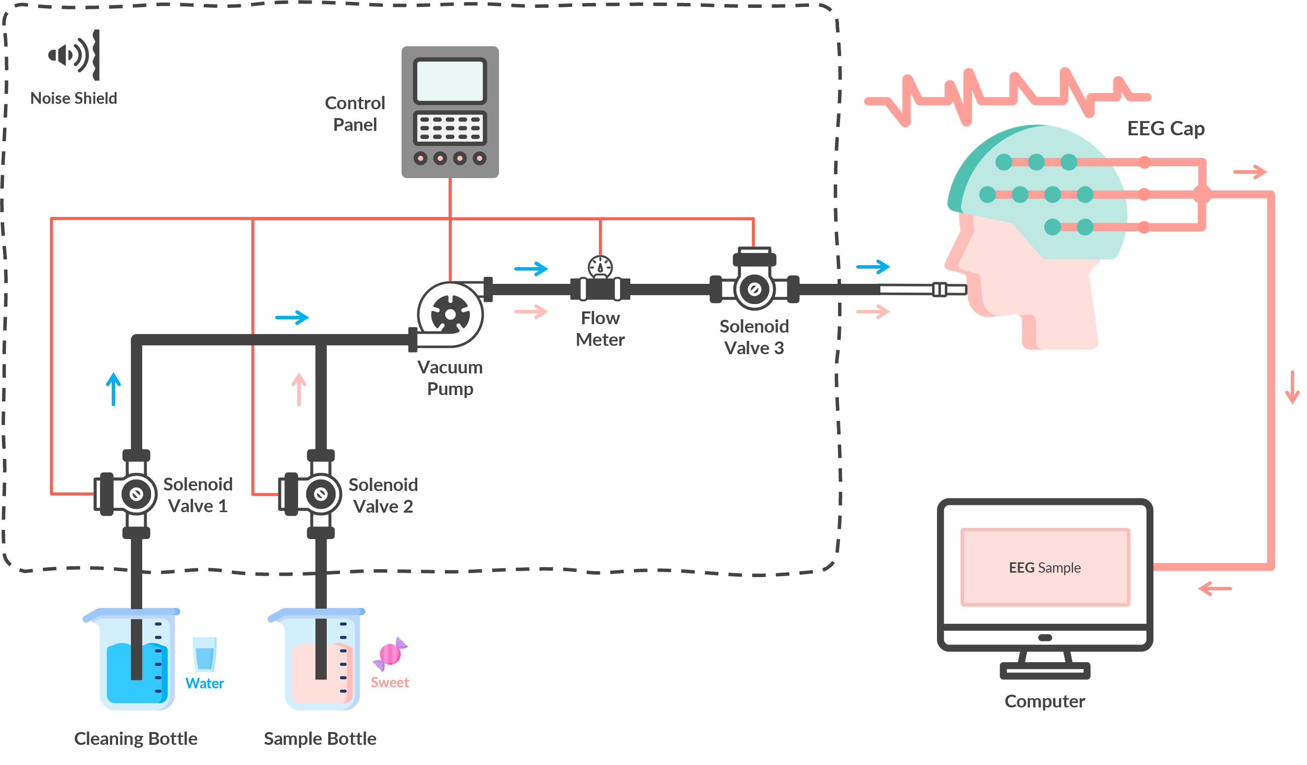






Taste-Evoker
EEG Acquisition
NCERP-P EEG
Acquisition System
256 Hz
Sampling Frequency
21-channel EEG cap
Electrode Setup
Self-Developed
Low-Noise
High-Precision and High-Stability

Slide 11









Warmed to 37.5 °C
Environment
21 ± 2 °C
Water
Sweet
Sour
Bitter
Pre-Experiment Setup
Salty
100 mL
Cleaning Solution
Stimulation Protocol
Taste Solutions
4
Subject wears EEG cap, earplugs, nasal plugs, and uses a chin rest.
days
EACH DAY
Taste solution delivered via the evoker: tube positioned 0.25–0.5 cm above tongue.
Subjects randomly receive all 4 taste stimulations.
Minimal
Electromagnetic Interference
Randomized taste selection ensures unbiased stimulation.
Subjects keep their eyes closed to avoid seeing the solution.

Slide 12
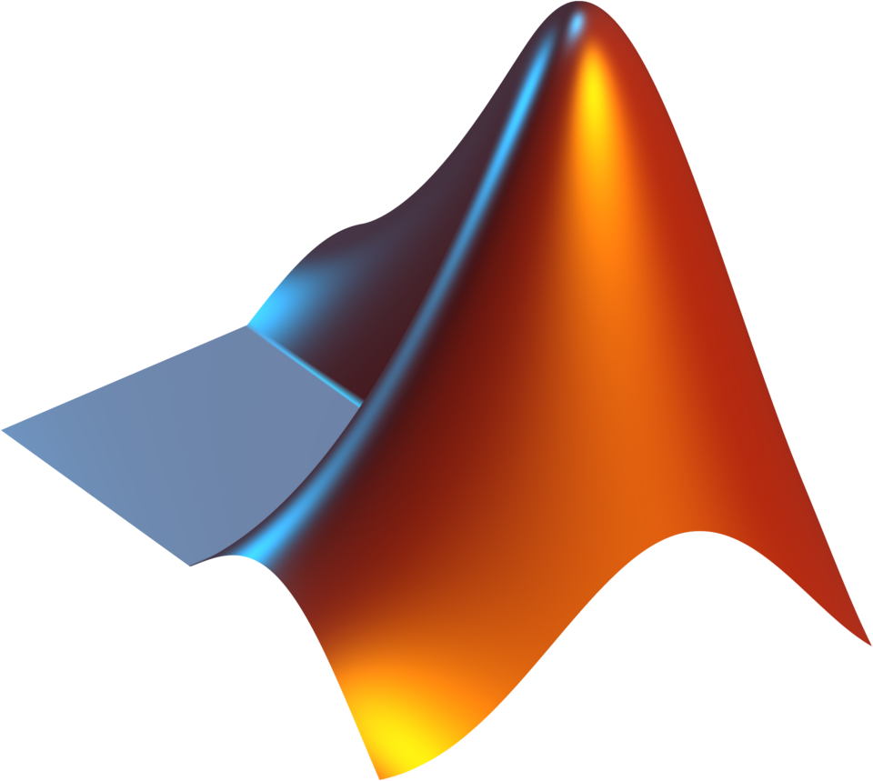

Preprocessing
Days
Segmentation
10s
MATLAB
Data Segmentation
20 × 4 × 4 × 5 = 1600 EEG samples
Preprocessed by MATLAB and its built-in toolkit EEGLAB.
Duration of each recorded segment during taste stimulation
Each segment divided into 5 samples (2s each)
TOTAL
Subjects
Tastes
0.5–50 Hz
49–51 Hz
From 256 Hz
Filtering & Downsampling
To 128 Hz
Bandpass Filtering
Notch Filtering
Downsample
Removes low/high-frequency noise
Eliminates power line interference
To reduce sample size
The final size of a taste-related EEG sample was 256 × 21
H
W

Slide 13
TSRDA
Temporal and Spatial Reconstruction Data Augmentation

Slide 14



CNNs require large amounts of data.
However, taste-related EEG datasets are generally limited due to experimental complexities.
Solution
Data Augmentation
Increasing the diversity and volume of training data is critical to enhance model performance and avoid overfitting.
Enhances diversity in both temporal and spatial features.
Training Challenge

Slide 15

Ingredients
(256)
W
Associated Label
Sweet
Salty
Spatial
EEG Sample
H
(21)
Sour
Bitter
Temporal
Pre-Processed Dataset

Slide 16
Recipe
1. Randomly select two EEG samples from the Pre-Processed Dataset
Sweet
Sour

Slide 17
Recipe
2. From both samples, cut an identically sized data block of dimensions w × h from the same location.
w
w
h
h
Sweet
Sour

Slide 18
Recipe
3. Insert the data block from the second sample into the first sample to create a newly reconstructed sample.
~ 0.81
~ 0.19
Sweet
Sour
The new sample is assigned two labels, with each label’s weight proportional to the area of the corresponding data block. During model training, these two labels are optimized according to their respective weights.

Slide 19


Recipe
Block Extraction Details
The location and size of the data blocks are not arbitrary
They are determined through hyperparameter optimization to maximize TSRDA’s effectiveness.
The centers of the cutting blocks are:
Evenly distributed along the temporal dimension;
Mainly in the lower half of the EEG channels (spatial).
The dimensions w and h are uniformly distributed over their respective ranges, [0, W] and [0, H].

Slide 20
TSCNN‑CA
Temporal and Spatial CNN with Channel Attention

Slide 21
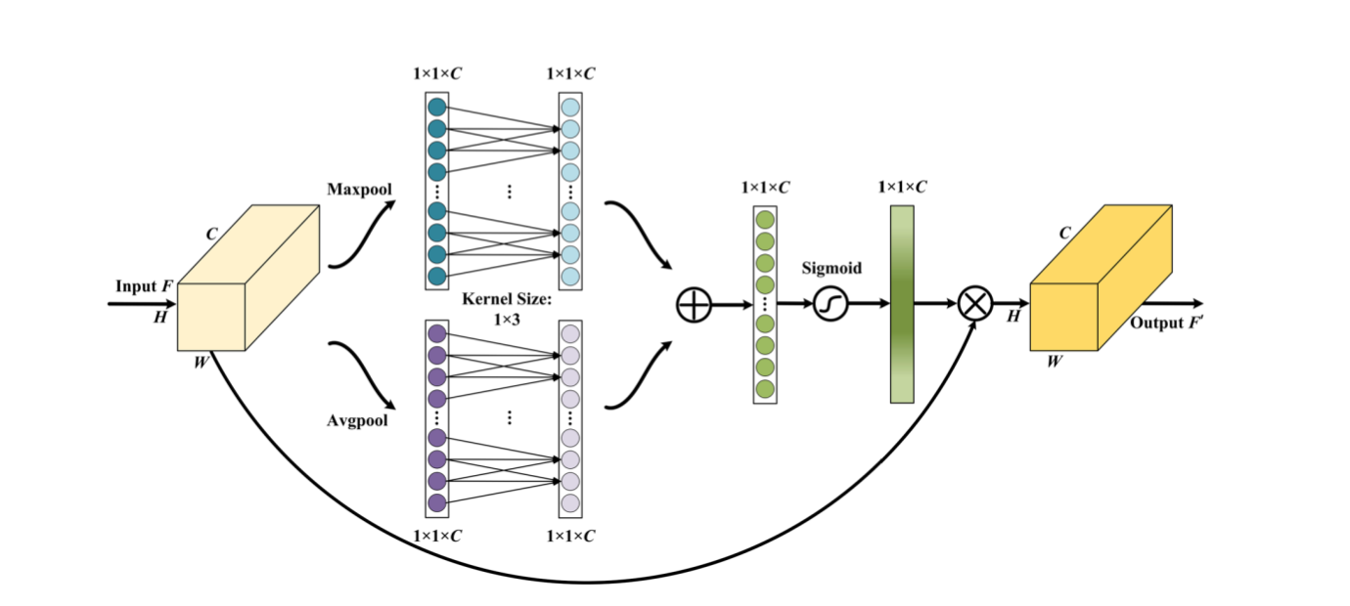

Multi‑View Channel Attention
Information Fusion
Adds pooled outputs
Nonlinear Activation
Generates attention weights
Global Max Pooling
Highlights the most prominent signals
Objective
Empower the CNN to focus on essential EEG features while minimizing redundancy.
Attention weights are multiplied by the original data
Global Average Pooling
Extracts the overall contextual features
One-Dimensional Convolution
Operates on the pooled features, promoting interaction across channels

Slide 22
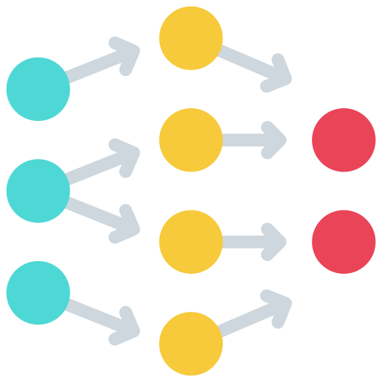

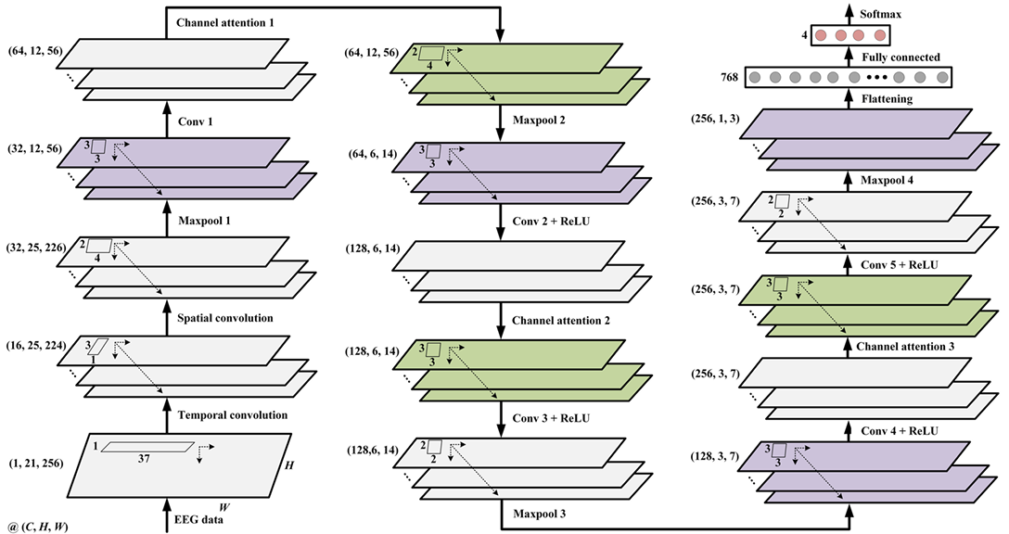
TSCNN-CA
Channel attention mechanism
CNNs
Have excelled in EEG classification by extracting rich, high-dimensional features.
Integrates both temporal and spatial convolutions to capture crucial patterns in taste-related EEG signals.
TSCNN-CA

Slide 23
Results and discussion

Slide 24
Taste-related EEG topographic map
Brain response under different stimuli
The average EEG topographic maps recorded under different taste stimuli reveal distinct patterns of brain electrical activity, indicating significant variation depending on the type of stimulus.
Bitter and sour taste shows pronounced electrical activity in the frontal, occipital and temporal lobes.
Sweet taste shows enhanced electrical activity in the parietal and temporal lobe regions
Salty taste primarily activated portions of the parietal and temporal lobe regions
Water triggers less brain activity than other tastes

Slide 25
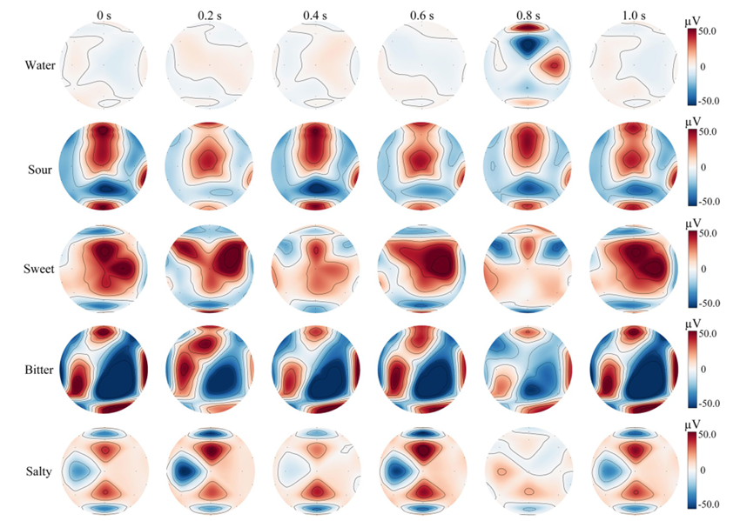

EEG Topography Maps
Frontal
Parietal
Occipital
Temporal

Slide 26
Taste-related EEG experimental settings
Experimental test and evaluation metrics
Taste-related EEG four-classification experiments for subject independence and subject non-independence were performed.
Subject independence
Taste-related EEG samples of each subject were the test set, and the other subjects were the training set.
Subject non-independence
A total of 1600 taste-related EEG samples from 20 subjects were randomly divided into training and test sets at 3:1.
Model Hyperparameter
Expansion multiple of the TSRDA to the training set was 3. Training set batch size 64 and test set batch size 32. Optimizer used Adam, number of epochs 100, learning rate 0.0005 and weight decay was 0.001.

Slide 27
Effectiveness analysis of TSRDA
Evaluation index | Before augmentation | After augmentation
Accuracy ± std (%) | 98.10 ± 2.03 | 99.56 ± 0.21
F1-Score ± std (%) | 98.09 ± 2.04 | 99.48 ± 0.31
Kappa ± std (%) | 97.39 ± 2.77 | 99.38 ± 0.29

Slide 28
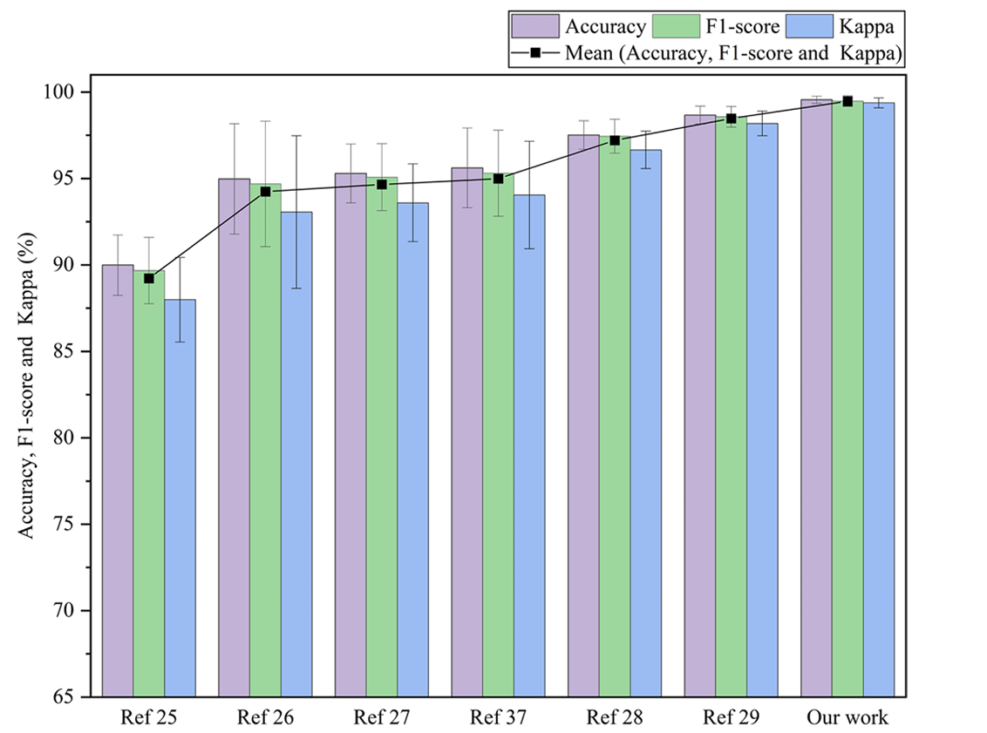
Comparison with state-of-art models
Reference | Augmentation method | Classification method
25 | Add Gaussian noise | ResNet
26 | Time division and reorganization | Shallow CNN
27 | Brain area recombination | EEGNet
37 | Sliding time windows segmentation | VGG-16
28 | Sliding time windows segmentation | Deep CNN
29 | CutCat | Deep CNN
This Paper | TSRDA | TSCNN-CA
TSRDA
Most techniques only focus on either temporal or spatial dimensions, not fully preserving the important local features.

Slide 29
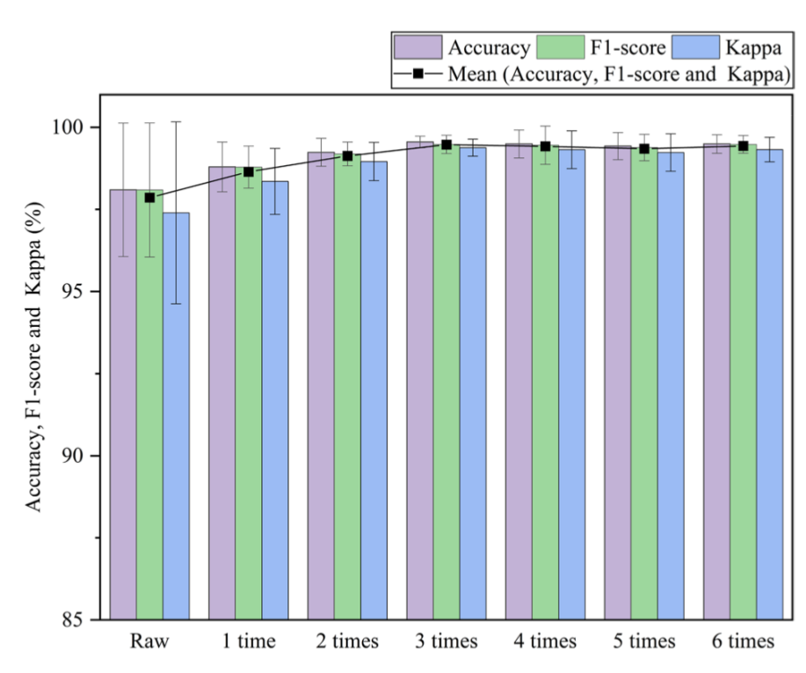
TSRDA: Data augmentation multiple
Inadequately trained model
Multiple
Information redundancy

Slide 30
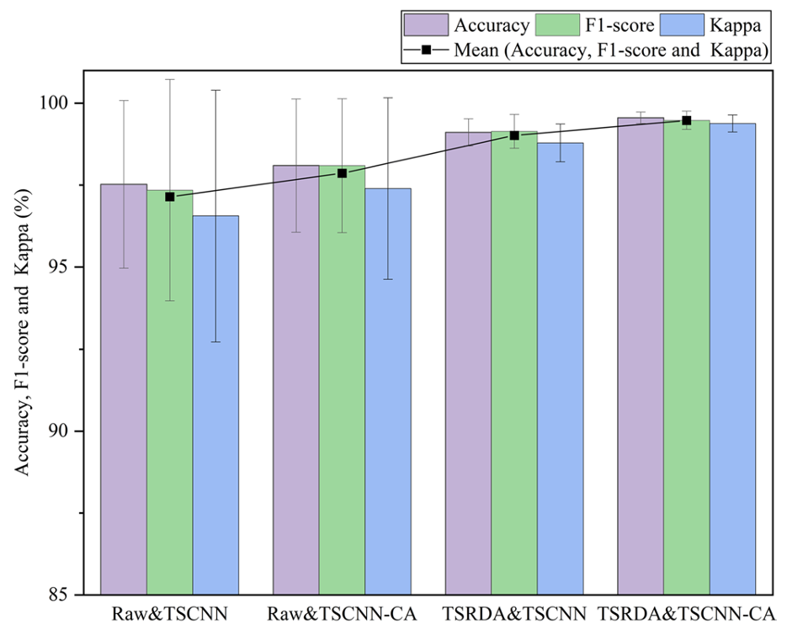

TSRDA and MVCA
TSCNN TSCNN-CA
The introduction of MVCA method can better mine the important features of taste-related EEGs, avoiding redundant information.
Raw TSRDA
TSRDA effectively augmented the raw training set, improving the recognition accuracy and stability of taste-related EEGs.

Slide 31




Subject-independent test
Challenges
Stability
Generalization ability
Individual differences

Slide 32
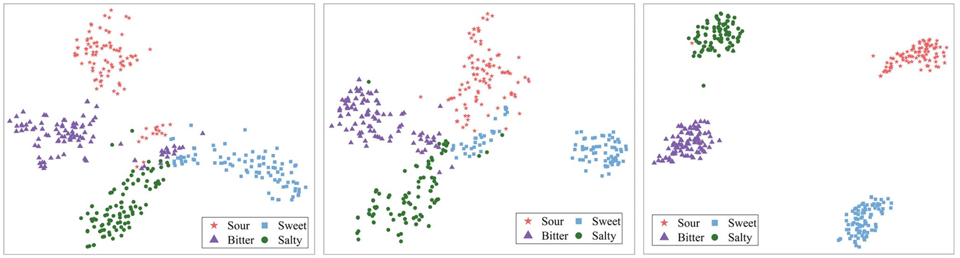
t-SNE Visualization of test set
Raw & TSCNN
Raw & TSCNN-CA
TSRDA & TSCNN-CA

Slide 33
Future directions and critical analysis

Slide 34


Limitations and future directions
Dataset scale & Universality
Data Acquisition Challenges
Increasing the subject pool is crucial for broader applicability. Cross-subject EEG recognition remains a significant challenge.
Taste-related EEG collection is costly and time-consuming, limiting dataset size. TSRDA offers a promising solution to augment limited data, though it may sometimes introduce redundant information.

Slide 35


Limitations and future directions
Enhancing Feature Extraction:
Automation & Optimization:
The MVCA module effectively mitigates redundant information, improving feature discrimination. Future work will explore applying these methods to other EEG tasks.
Currently, TSRDA relies on manual selection for reconstructing optimal temporal–spatial features. Integration of automatic methods (e.g., Grad-CAM) is planned to streamline reconstruction and boost effectiveness.

Slide 36


Is the experiment reliable?
Data split ambiguity:
The paper only discusses training and test sets, there is no explicit mention of a distinct validation set.
Training set
Hyperparameter Tuning Uncertainty:
It's unclear whether hyperparameter tuning was performed on a separate validation subset.
Test set
Without a dedicated validation set, it’s uncertain if the model’s tuning and performance measures were optimally evaluated.
This may affect the reported generalizability of the results.

Slide 37
Conclusions

Slide 38



Conclusions
Robust EEG Acquisition:
An experimental paradigm was established that effectively acquired taste-related EEGs induced by sour, sweet, bitter, and salty tastes.
Effective Data Augmentation (TSRDA)
An experimental paradigm was established that effectively acquired taste-related EEGs induced by sour, sweet, bitter, and salty tastes.
Superior Classification (TSCNN-CA with MVCA):
Combining TSRDA with the TSCNN-CA—enhanced by a multi-view channel attention (MVCA) module—ensures comprehensive model training and effectively mitigates redundant information for accurate taste decoding.
Overall Impact & Limitations
The combined approach outperforms state-of-the-art methods in decoding EEG signals for the four basic tastes. Although effective for basic tastes, the method does not yet accommodate mixed flavours—an area targeted for future research.

Slide 39
Thanks
for your attention

Slide 40
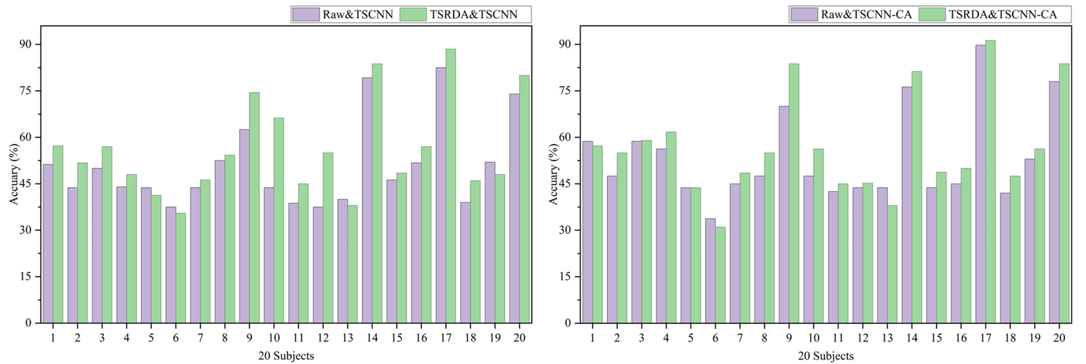
Subject-independent test

